Slide 1
Queue
Topic/Course
Sub-Topic (Example: name of college)
Notes:
Cover Page
Font: Nunito Sans
Primary colors: Black, White and Red (#F05136)
General Instruction:
Don’t edit this PPT (keep it for future reference)
Copy paste the required slide into your PPT. Format it there.
Write less, talk/present more
Use the font Nunito Sans Regular. You can download it from google fonts (https://fonts.google.com/specimen/Nunito+Sans).
Don’t change the size and/or positions of headings, texts, unless absolutely necessary. (minimum size: 20)
The size of the image must be adjusted according to the text. (try to make it look visually attractive)
1 image per slide. No more than 4 points per slide.

Slide 2
Queue
Element is inserted from REAR and deleted from FRONT.
Front points to the beginning and Rear points to the end.
Queue follows the FIFO (First - In - First Out) structure.
Notes:
Title + Bullets
No more than 4 points. Please use another similar slide incase you have more points.

Slide 3
Queue
One end is always used to insert data (enqueue)
The other is used to delete data (dequeue), because queue is open at both its ends.
Notes:
Title + Bullets
No more than 4 points. Please use another similar slide incase you have more points.

Slide 4
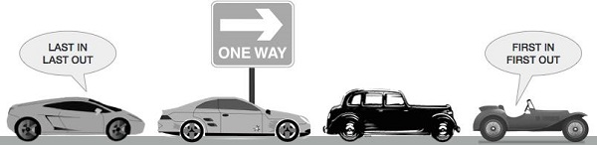
Real time example

Slide 5


QUEUE
Back < Front. Means, the Queue is empty.
Back = Front. Means, the Queue has only 1 element.
1
2
3
Front=
-1
0
1
2
3
QUEUE
Dequeue
Enqueue
Enqueue and Dequeue
Back=
-1
0
1
2

Slide 6

Real time example

Slide 7
Types of Queue
Simple Queue
Circular Queue
Priority Queue
Double Ended Queue

Slide 8
Circular Queue
In circular queue, each node is connected to the next node in sequence.
But the last node’s pointer is also connected to the first node’s address.
Hence, the last node and the first node also gets connected making a circular link overall.
Notes:
Title + Bullets
No more than 4 points. Please use another similar slide incase you have more points.

Slide 9
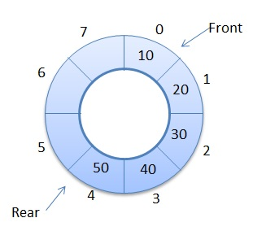
Circular Queue
Notes:
Title + Bullets
No more than 4 points. Please use another similar slide incase you have more points.

Slide 10
Priority Queue
Priority queue makes data retrieval possible only through a pre-determined priority number assigned to the data items.
While the deletion is performed in accordance to priority number (the data item with highest priority is removed first), insertion is performed only in the order.
Notes:
Title + Bullets
No more than 4 points. Please use another similar slide incase you have more points.

Slide 11
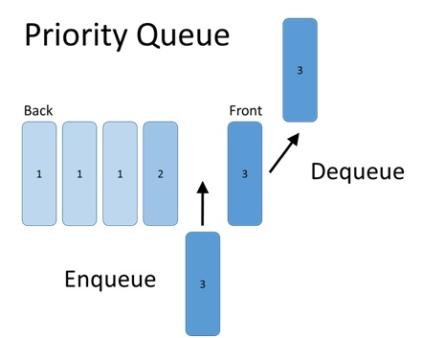
Priority Queue
Notes:
Title + Bullets
No more than 4 points. Please use another similar slide incase you have more points.

Slide 12
Double Ended Queue - Dequeue
The doubly ended queue or dequeue allows the insert and delete operations from both ends (front and rear) of the queue.
Queues are an important concept of the data structures and understanding their types is very necessary for working appropriately with them.
Notes:
Title + Bullets
No more than 4 points. Please use another similar slide incase you have more points.

Slide 13
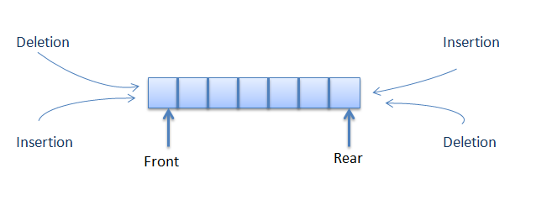
Double Ended Queue - Dequeue
Notes:
Title + Bullets
No more than 4 points. Please use another similar slide incase you have more points.

Slide 14

THANK YOU
Notes:
Thank you slide

